Slide 1
National Transonic Facility Public Geometry Release and Summary
Brent Pomeroy
Configuration Aerodynamics Branch
NASA Langley Research Center
Scott Brynildsen & Norma Farr
Geometry Lab Group
NASA Langley Research Center
Melissa Rivers
Transformational Tools and Technologies Project
NASA Langley Research Center
Ben Rider
High Speed Aerodynamics, Flight Sciences
Boeing Commercial Airplanes
Eric Walker
Chief Engineer for Test Operation Excellence and Research Directorate Chief Engineer Council Chair
NASA Langley Research Center
Seyedeh Sheida Hosseini
Transformational Tools and Technologies Project
NASA Ames Research Center

Slide 2
Outline
Facility Overview
History
Key CRM Tests
CRM Coordinate Transformations
Geometry Files

Slide 3
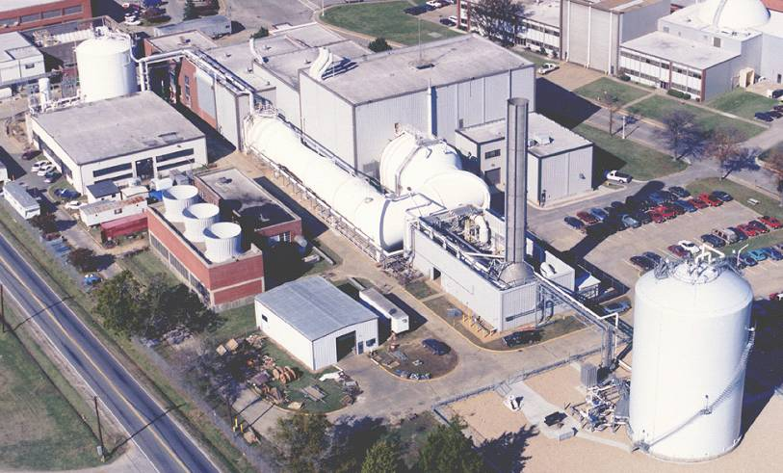
Facility Overview
Closed circuit, pressurized, cryogenic facility
Located at NASA Langley Research Center in Hampton, VA, USA
Facilitates transonic, flight Reynolds number (Re) testing
Mach 0.1 to 1.2
Re 4.0 million to 145 million/foot 1.2 million to 44 million/meter
Temperature -250 to 130 deg F (-157 to 54 C; 116 to 328 K)
Can operate with dry, ambient air or with gaseous nitrogen
Source: NASA

Slide 4
Key Historical Dates
1960s Facility needs identification
1970-1973 Conceptual design
1971-1973 Risk reduction facility tests
1974-1978 Detailed design
1976 Funding appropriated
1979 Construction started
1982 Construction complete
1984 Open for production
2001 Aerospace Sciences Meeting (first open discussion of capabilities)

Slide 5
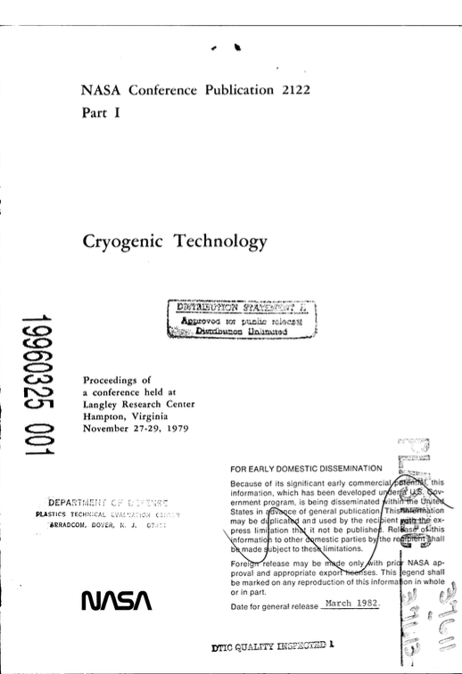
History and Conceptual Design
Established an international need for high Reynolds number testing
Desired for decades before construction
Interest from academia, industry, and government
Detailed facility requirements study formalized in 1971
Matured by Department of Defense, NASA, commercial partners, and scientific advisory committees
Many workshops with partners and customers
Identified three ways to increase Reynolds number
Increase P_{total}
High molecular weight fluid
Reduce T_{total}

Slide 6
Configuration Selection
Two final configurations candidates
Short-run, high-pressure Ludwieg tube
Continuous-run cryogenic nitrogen facility
Cryo facility selected for five key reasons
Temperature has a large effect on Reynolds number at low temperatures
High Reynolds numbers can be tested
Reduced temperature → reduced speed of sound → decreased velocity → decreased fan power
Cryo nitrogen is similar to ambient, high-altitude flight conditions
Independent control of total pressure, total temperature and fan speed

Slide 7
Risk-Reduction Facilities
Two risk-reduction facilities constructed prior to NTF funding approval
Low-speed cryogenic benchtop wind tunnel (1971)
7 inch by 11 inch (18 cm by 28 cm) test section
Low speed (up to Mach 0.2)
Operated down to 80 K (-316 F, -193 C)
Confirmed liquid nitrogen injectors can create cryo conditions
Identified requisite material behavior at cryo temperatures
Langley 0.3-Meter Transonic Cryogenic Tunnel (1973)
Small-scale version of proposed NTF
Transonic, cryogenic
Designed to operate for 90 days; still in operation for technology-development experiments
Funding for NTF appropriated in 1976

Slide 8
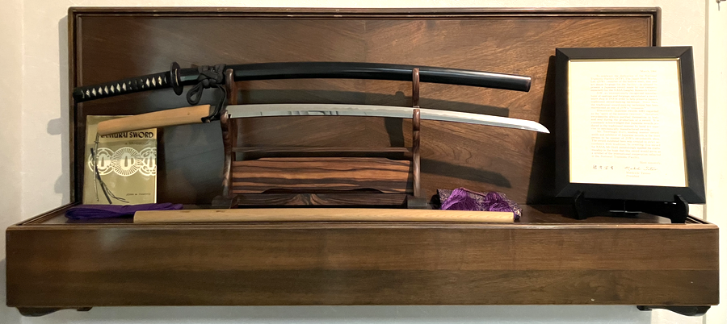
Test Environment Challenges
Materials advancements needed to ensure facility and model integrity
Japan Steel material improvements
Developed high-strength 9% Nickel maraging steel
Stronger materials and increased maximum part size than availably domestically
Urban legend that Japan Steel was used due to a domestic steel shortage
Samurai sword friendship gift
Made with traditional techniques
Offered to NASA “... in hope that this sword would serve as a symbol of the international cooperation reflected in the National Transonic Facility”
Sword is on display in the NTF building
Source: NASA

Slide 9
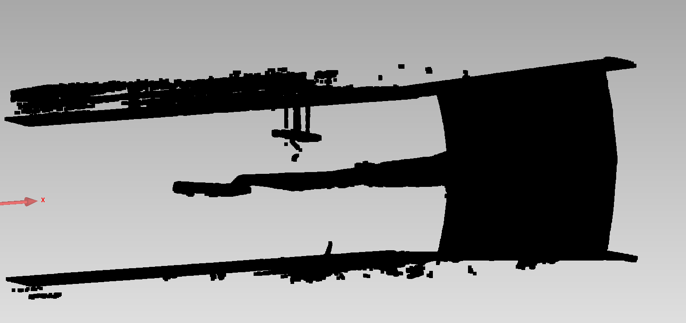
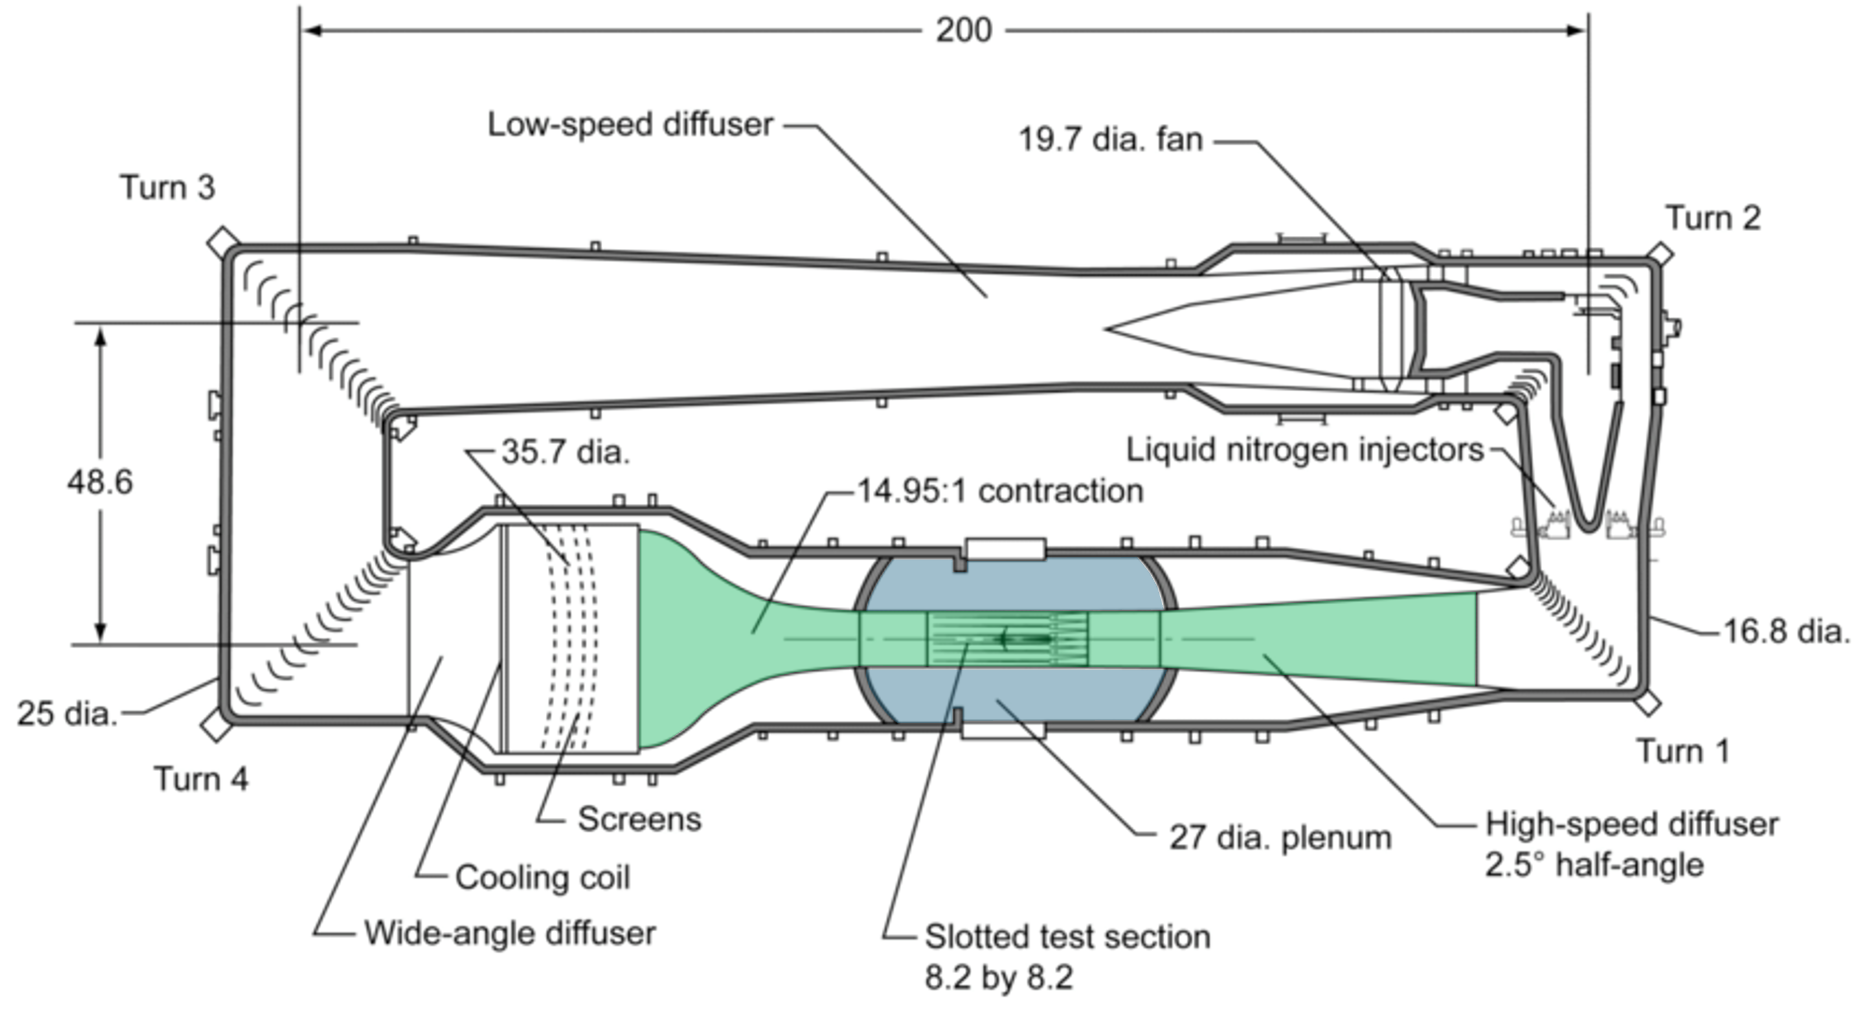
Facility Digital Model
Detailed digital scan of NTF circuit was taken in the mid-2010s
About 250 million points
Approximately 80% of the points are in the plenum
Significant work with GeoMagic used to generate CFD-ready surface geometry
High-speed leg geometry and model support hardware has been released
Point cloud data
Tunnel circuit, high speed leg (green), and plenum (blue)

Slide 10
Key Common Research Model (CRM) Tests
CRM
Original transonic tests performed in support of Drag Prediction Workshop IV
High-quality experimental data facilitated detailed CFD comparisons
Tests NTF-197, NTF-215, and NTF-229
CRM-HL
Low-speed NTF test supplemented already-existing data sets
Special session Wednesday morning in Academy 415 (GT-10/APA-26)
Test NTF-237
CRM-NLF
Designed with Crossflow-Attenuated Natural Laminar Flow (CATNLF) method
Temperature-sensitive paint used to visualize regions of laminar/turbulent flow
Test NTF-228

Slide 11
Coordinate Transformation Overview
Different models require different transformations
Full-span, upper-swept strut mounted vehicle
Semispan, sidewall mounted vehicle
Four main steps
Rig the full-scale vehicle in the tunnel at model scale
Add sidewall standoff, if necessary
Rotate mounting hardware to achieve zero-deg alpha, if necessary
Rotate vehicle and associated hardware for non-zero alpha

Slide 12
CRM Mounting Options
2.7% full-span
Traditional CRM
CRM-HL (planned test)
Upper swept strut
5.2% semispan
CRM-HL (GT-10/APA-26, Wednesday morning, Academy 415)
CRM-NLF
2.7% semispan CRM-HL (planned test)
Coordinate transformations provided in the accompanying paper
Two example transformations on the next two slides

Slide 13
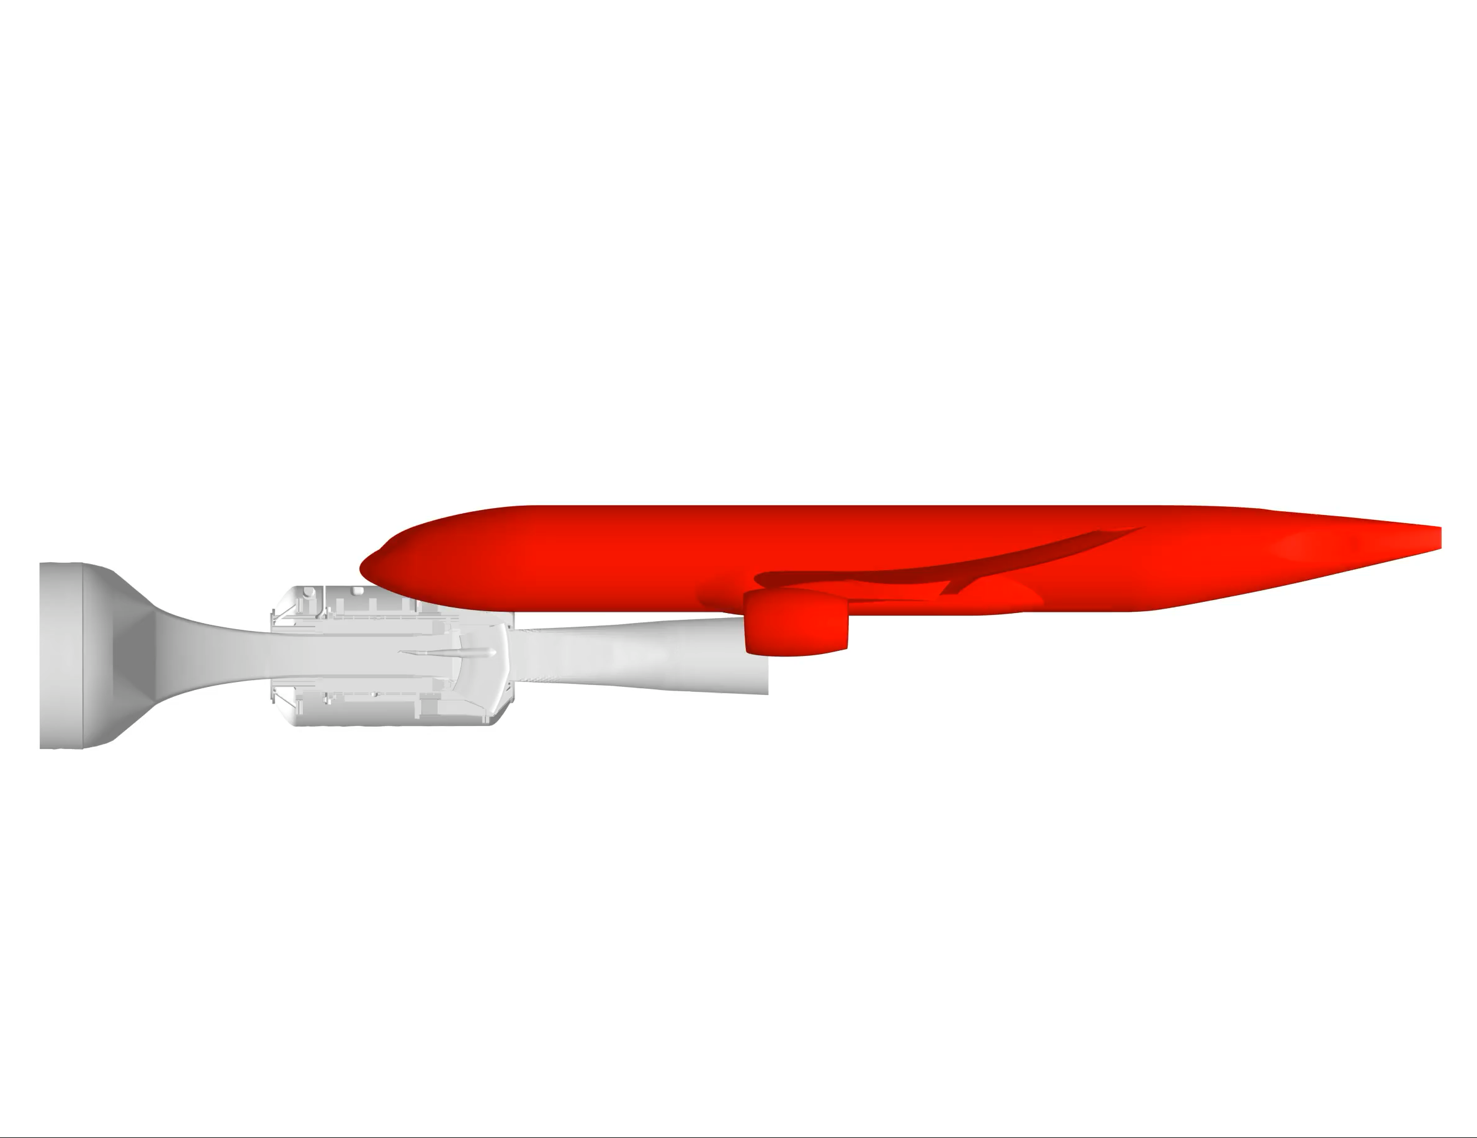
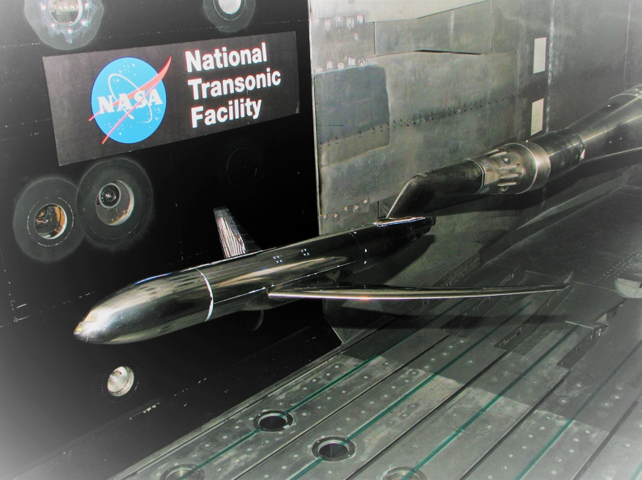
Full-Span 2.7% CRM Coordinate Transformations
Equations maintained from previously-listed information for consistency
Transformations included in in CAD release
Scale vehicle
Translate to model origin in the wind tunnel
Rotate arc sector and upper-swept strut around y axis
Rotate arc sector, upper-swept strut, and vehicle for non-zero alpha
how_mounted_2p7.txt
Source: NASA

Slide 14
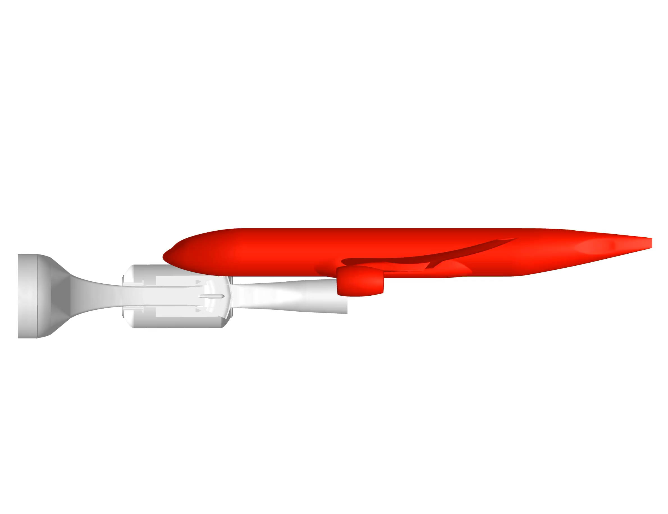
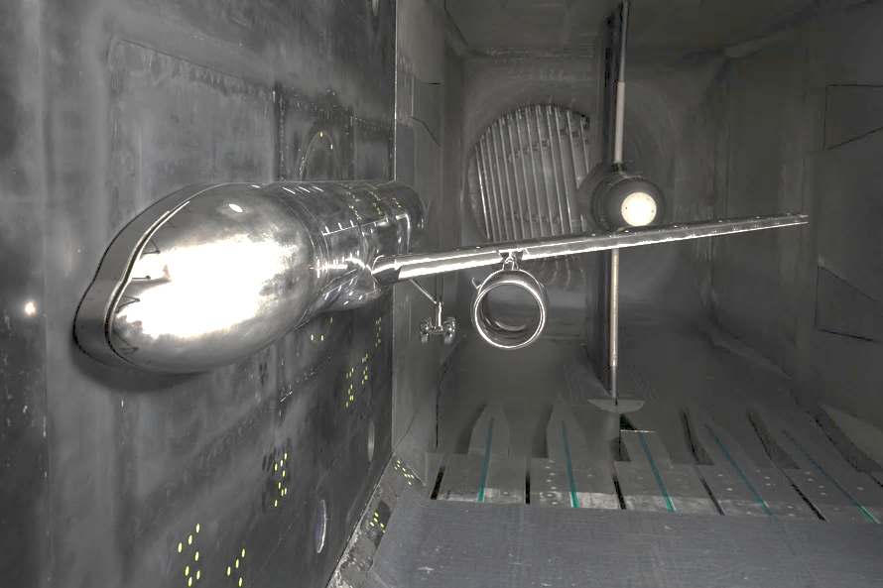
Semispan 5.2% CRM Coordinate Transformations
Version 1.9 has new transformations from historically published transformations
Transformations included in in the CAD release
Translate and scale to wind tunnel model origin
Add a standoff between the model and the wall
Rotate vehicle for non-zero alpha
how_mounted_5p2semispan.txt
Source: NASA

Slide 15

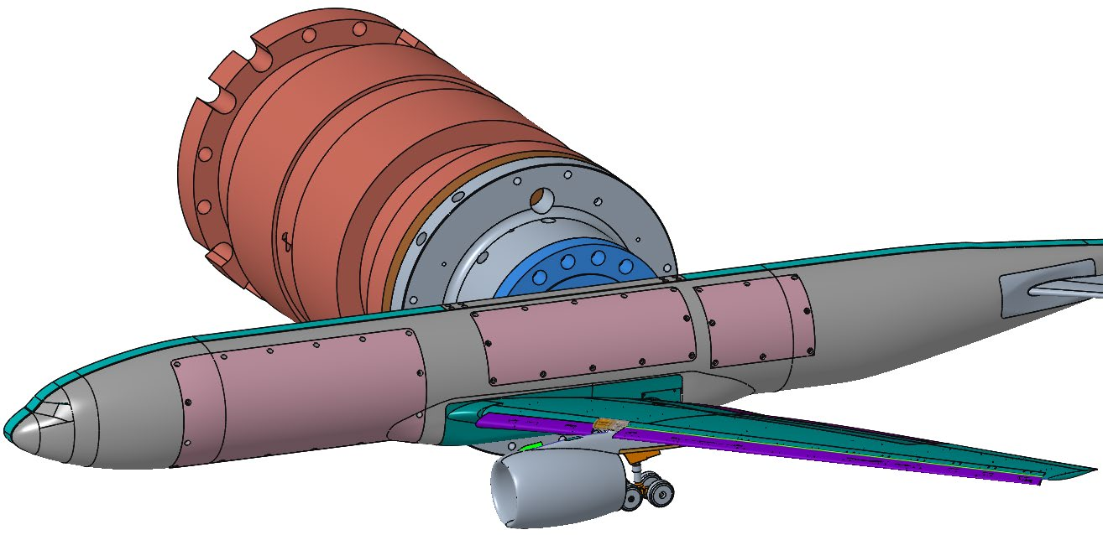
Semispan 2.7% CRM Coordinate Transformations
Version 1.9 has transformations not previously published
Transformations included in in the CAD release
Translate and scale to wind tunnel model origin
Add a standoff between the model and the wall
Rotate vehicle for non-zero alpha
how_mounted_2p7semispan.txt

Slide 16
High-Speed Leg and Plenum

Slide 17
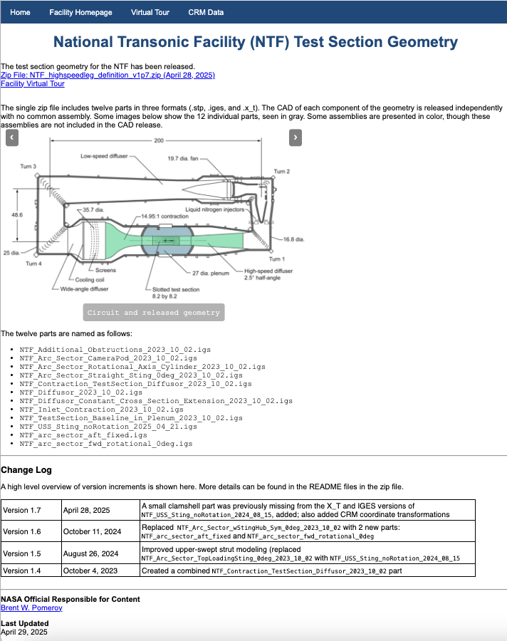
Geometry Download
Posted to DPW website ( )
Current version: v1.9 (June, 2025)
Contains
12 files
.igs, .stp, and .x_t
All in inches
https://aiaa-dpw.larc.nasa.gov/ntf.html

Slide 18
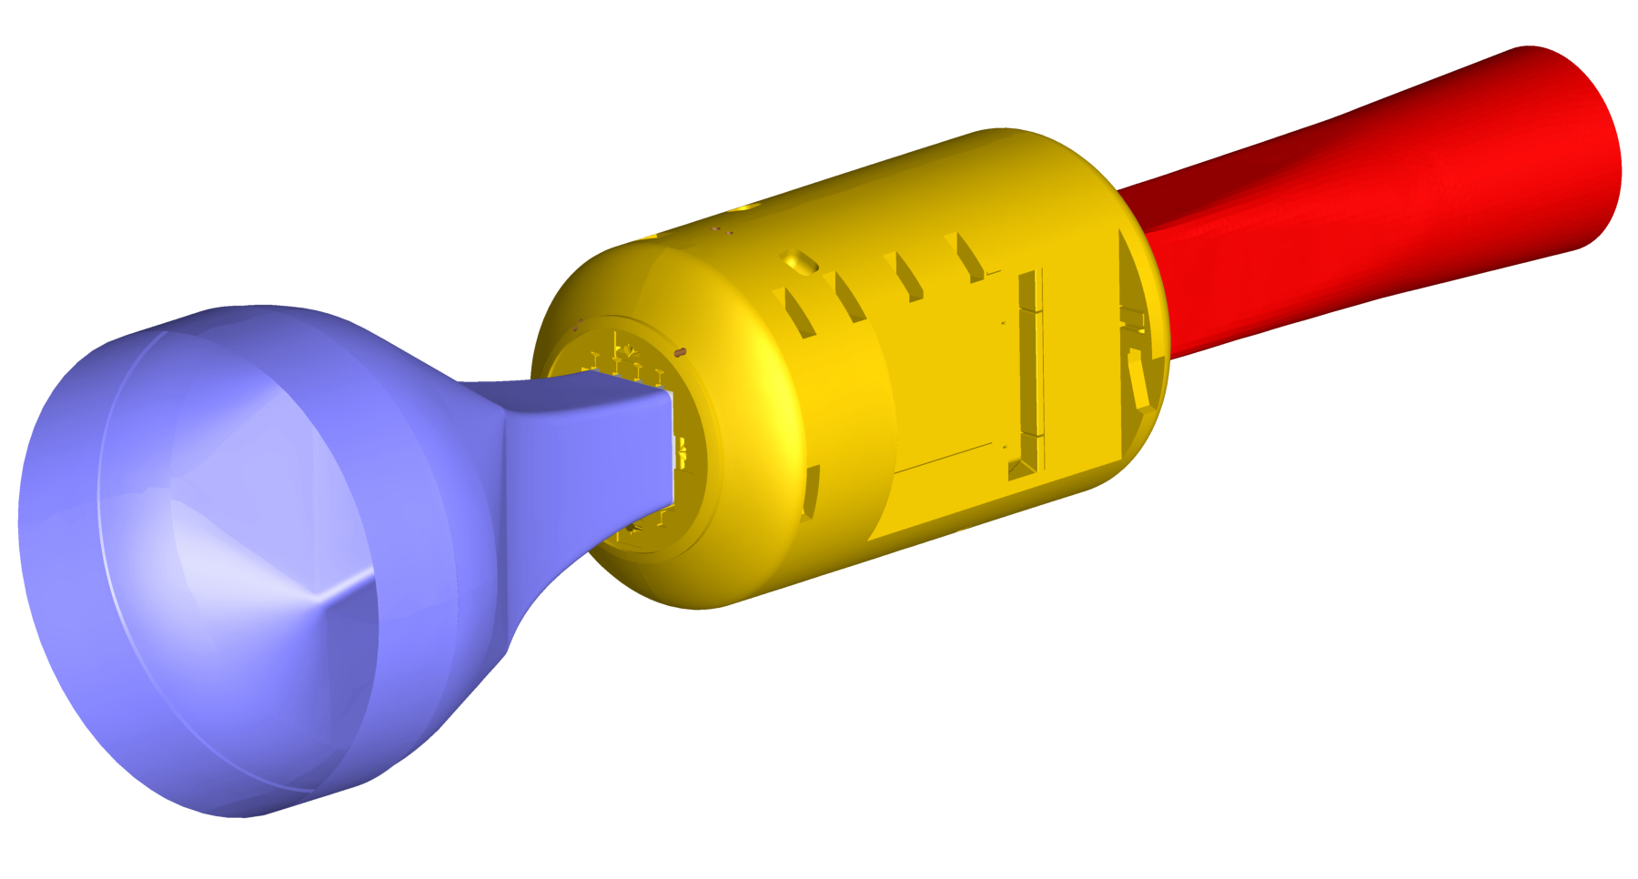
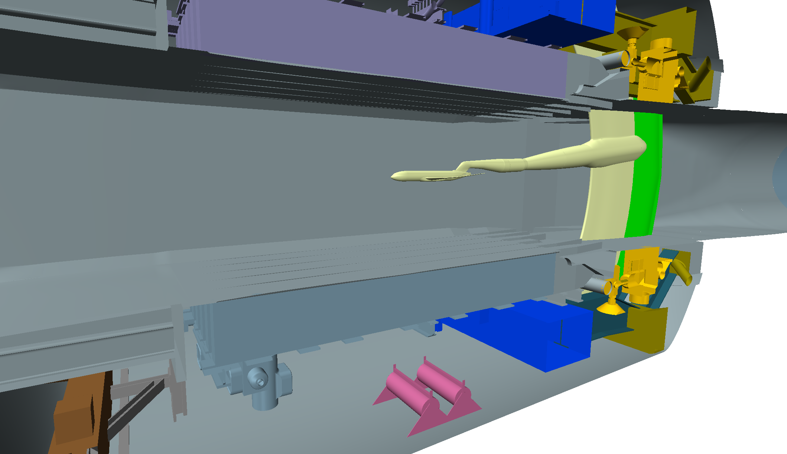
Geometry Overview

Slide 19
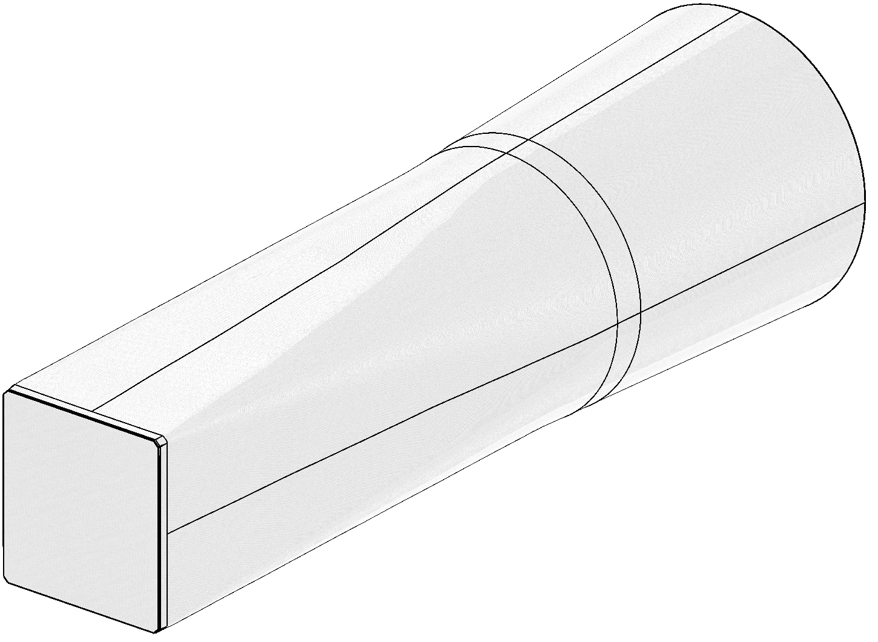
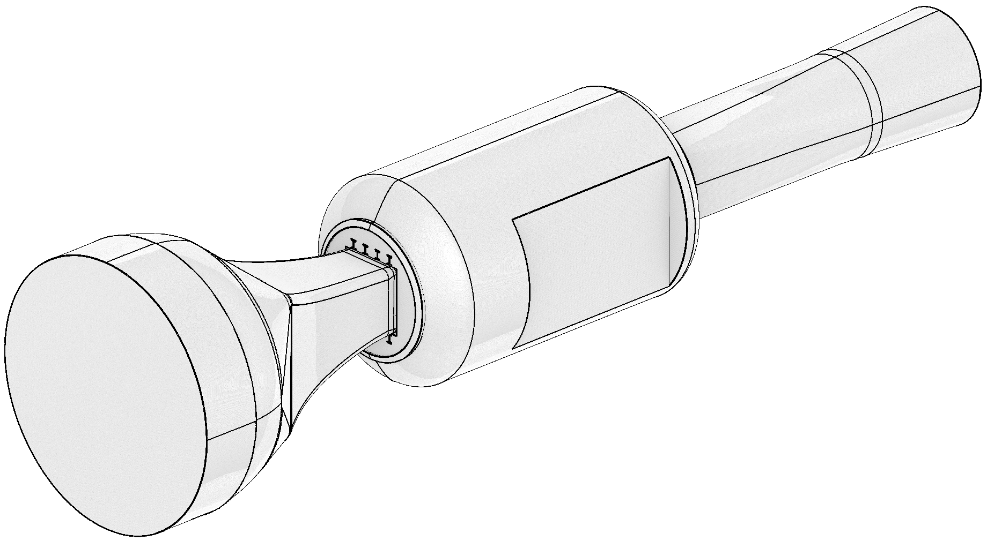
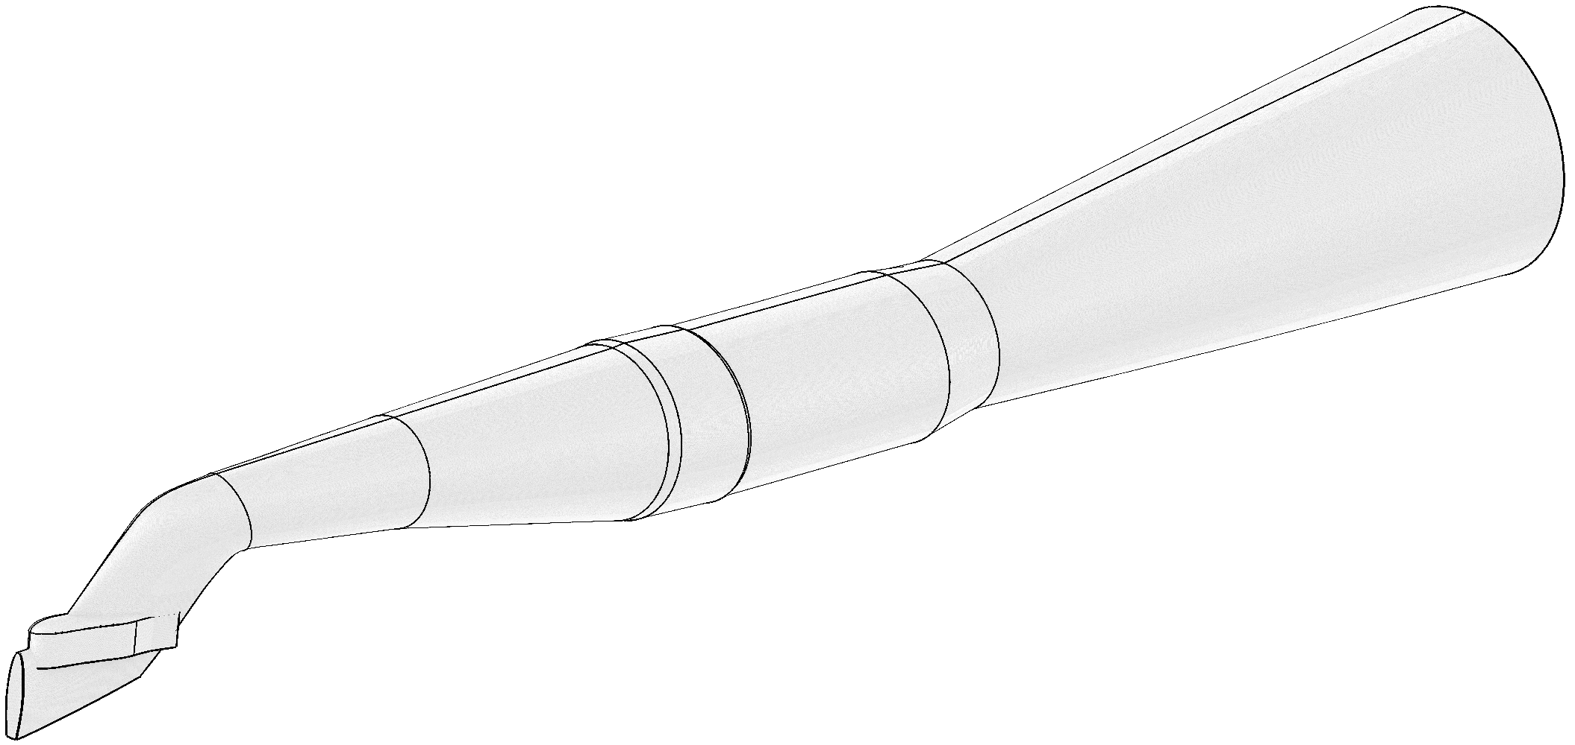
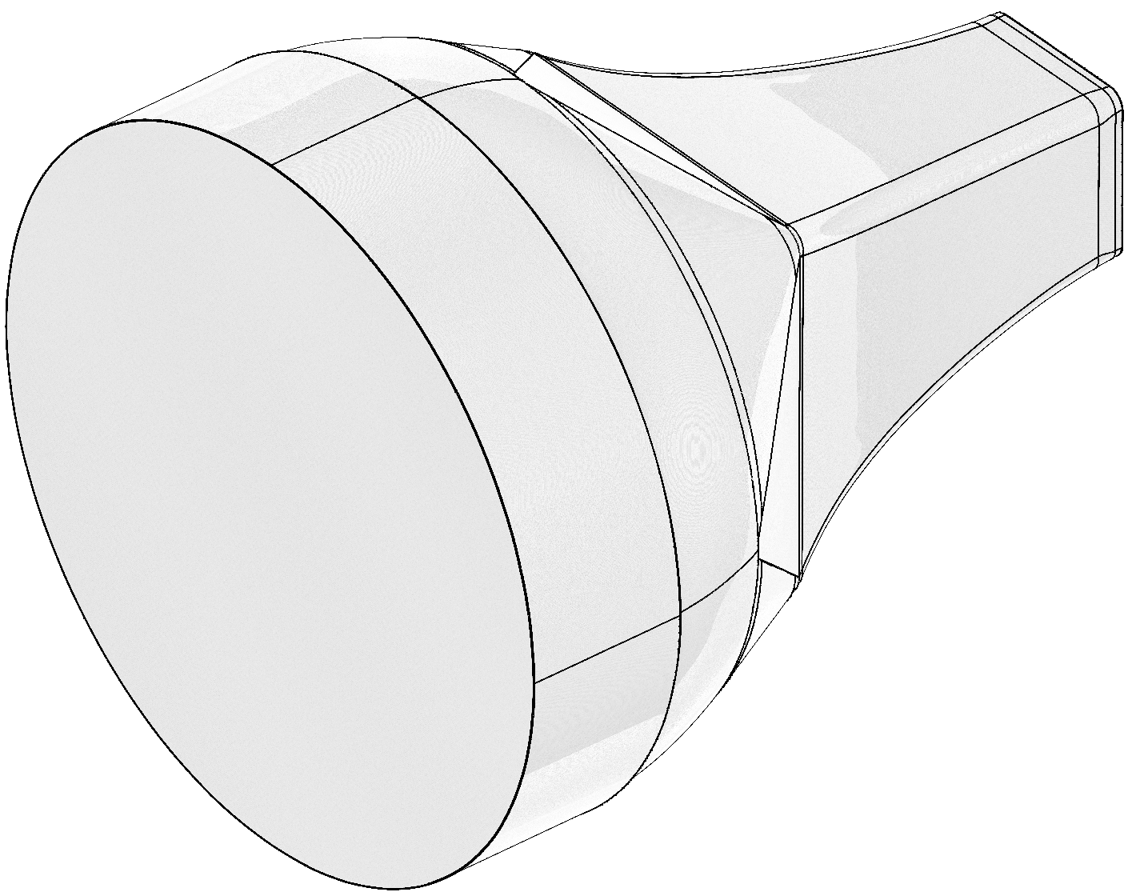
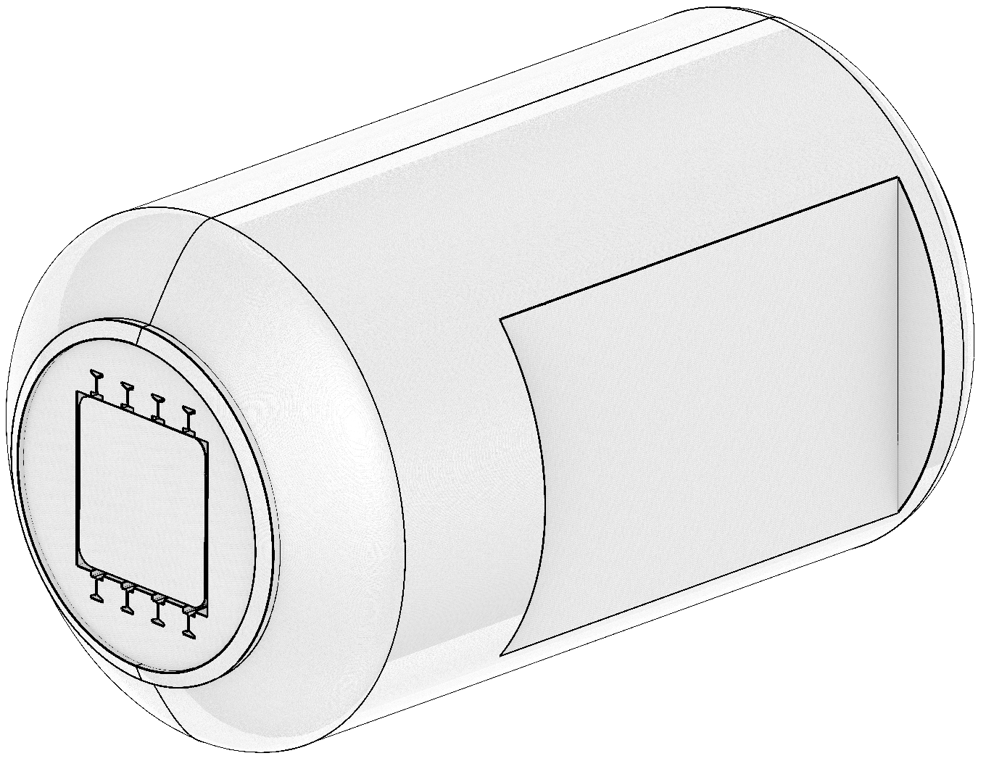
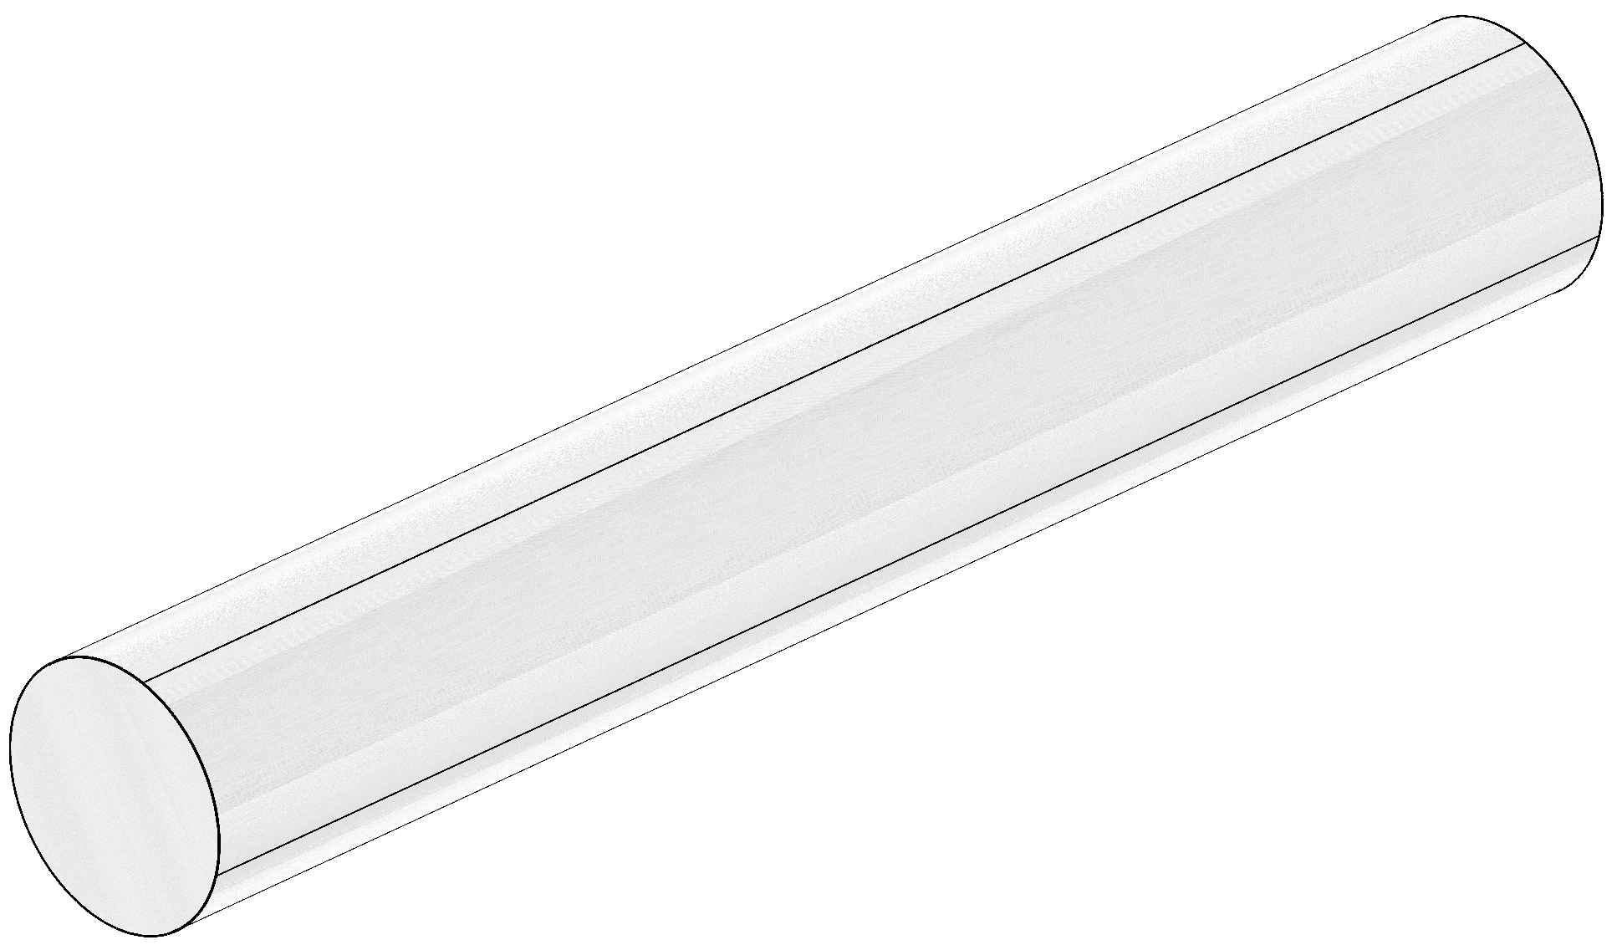
Geometry Files (1/2)
Note: The diffuser extension is not part of the NTF. It is provided in the CAD so boundary conditions can be applied further away from the test section. This may be desired to avoid potential numerical problems at the end of the diffusor. Use is optional.

Slide 20
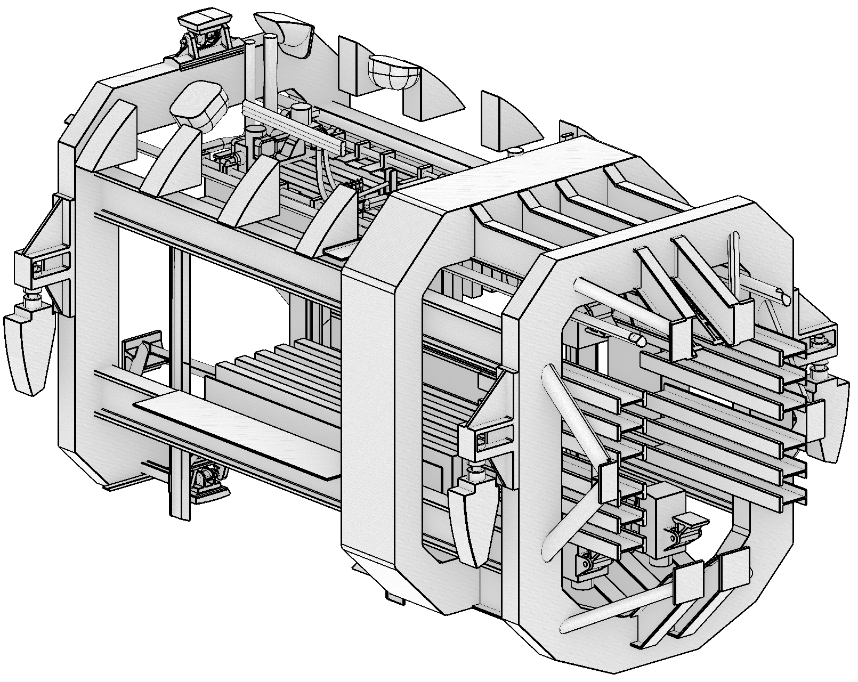
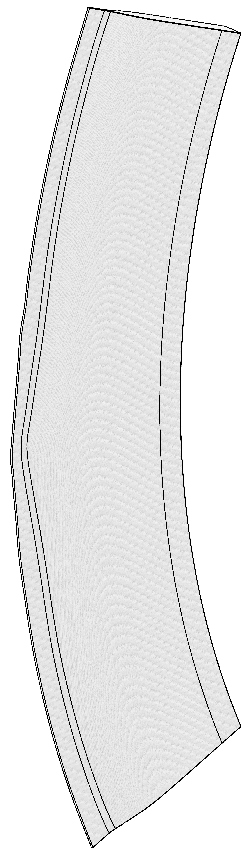
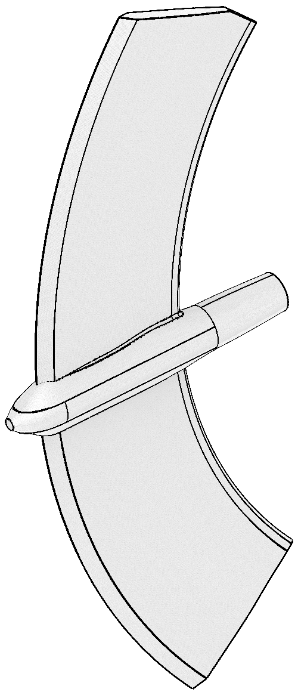
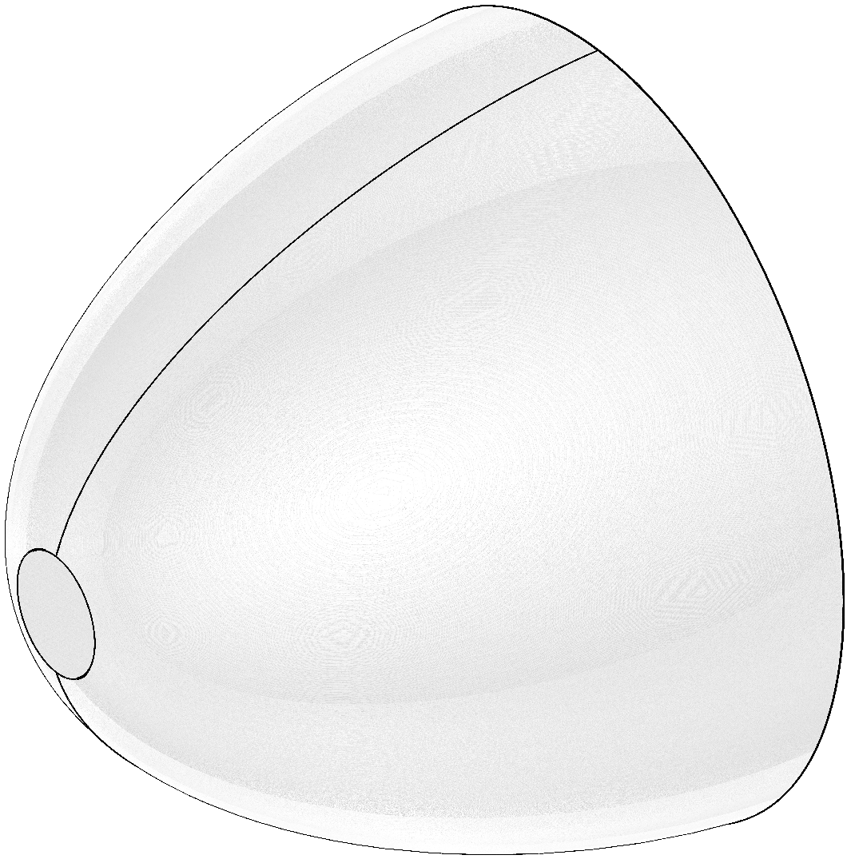
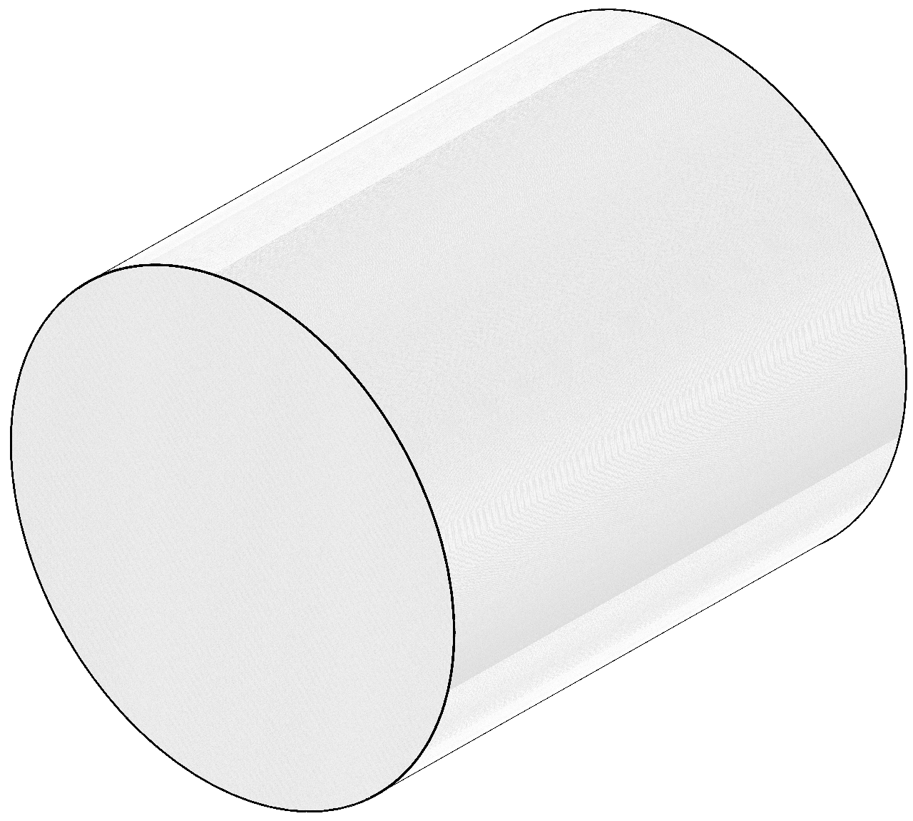
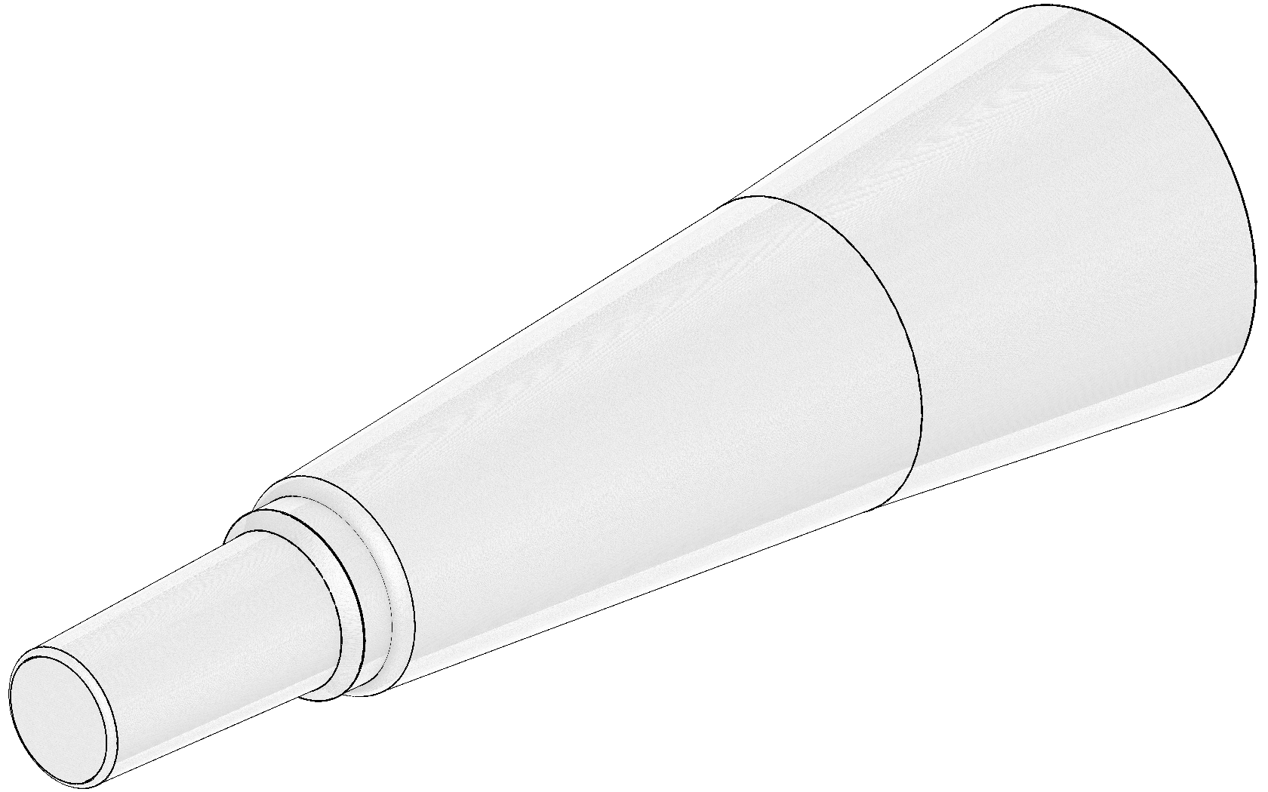
Geometry Files (2/2)

Slide 21
DPW-8/AePW-4 Usage
Test case for Test Environments Working Group
Consistent shift of CFD results relative to experimental data
Multiple items may cause the differences
Wall effects?
Tare and interference?
Physical geometry differences?
Freestream (i.e., inlet) conditions?
Complex geometry will require meticulous preparation and careful gridding

Slide 22
Conclusions
NTF has a storied history of tests, including three CRM configurations
Detailed digitization of NTF circuit
Publicly available high-speed leg CAD has been released (v1.9) at https://aiaa-dpw.larc.nasa.gov/ntf.html
Test case of interest for DPW-8/AePW-4 Test Environment Working Group

Slide 23
Special Thanks
Chris Rumsey
Miranda Ertsgaard
Courtney Winski
Andy Kwok

